Slide 1
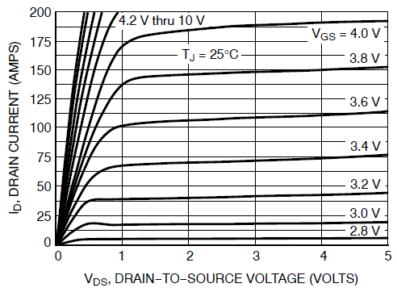
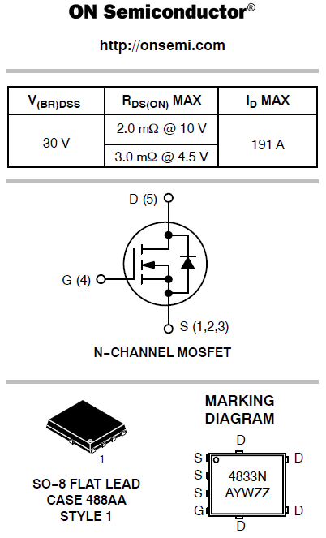
NTMFS4833N
Figure 1. On−Region Characteristics
Aus dem Datenblatt von

Slide 2
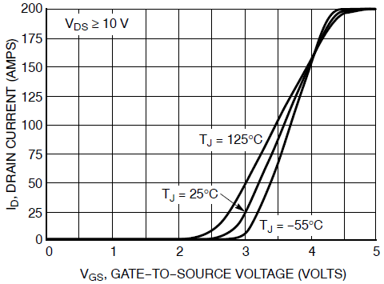
Figure 2. Transfer Characteristics

Slide 3
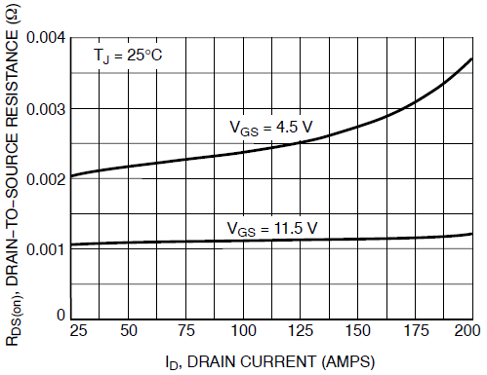
Figure 4. On−Resistance vs. Drain Current and Gate Voltage

